Slide 1
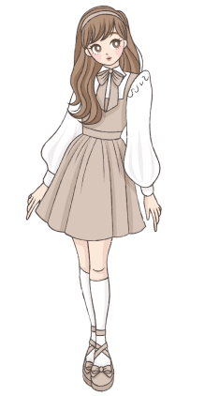


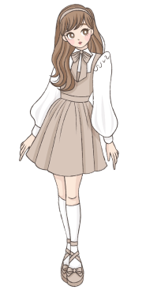
27
“Peepo”
girls
boys
27 girls in box named girls and Peepo in box named boys

Slide 2




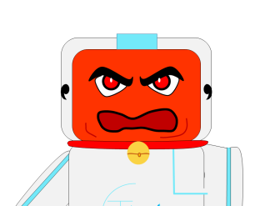
98
95
boys
girls
Replaced ‘Peepo’ with 98 boys
(it will have consequences)
Changed mind , added 95 no of girls

Slide 3
98
98
gentlemen
boys
New box
When I say gentlemen = boys In the code, it means “Python, create a new variable gentlemen and store the current value of boys in that variable. “ . And In future, if value of gentlemen is changed, it will not affect the box boys

Slide 4
It is like you copy an answer from a friend and later you think to change something in the answer you copied… It wont change the answer of your friend. And if you don’t change, your and your friend’s answer will remain same.
(unless your friend changes his answer)
NOW,
gentlemen
15
Suppose I changed my answer

Slide 5
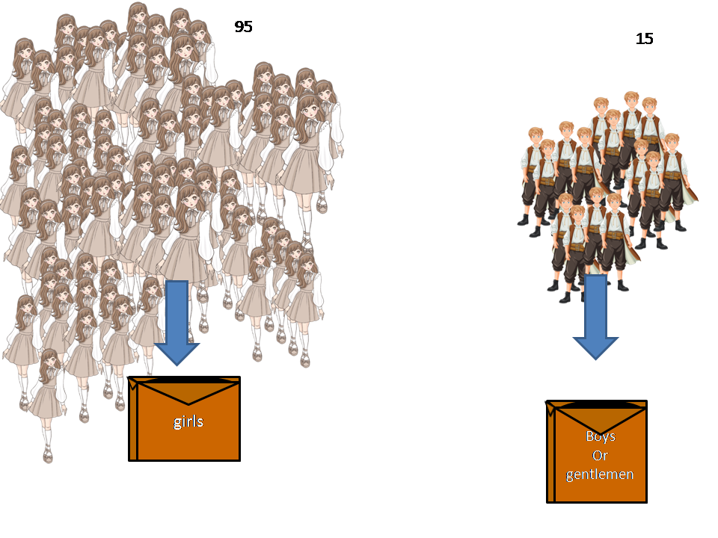
gentlemen
girls + gentlemen = 110

Slide 6
98
95
girls
boys

Slide 7


Add no of girls and boys or value of these boxes and give me total number
Print(girls + boys)
OK
gentlemen
girls
110
(girls+gentlemen)
95 (girls)
15(gentlemen)
Boys
girls
193
(girls+boys)
95 (girls)
98 (boys)

